Slide 1

Anatomy of a serverless GitHub Bot
How we built a serverless GitHub bot using Azure for the Microsoft hackathon.
https://github.com/Chris-Johnston/PublishScheduler
Notes:
Hey there, if you can read these notes, well, they aren't for you.
Also, I'm totally writing these on the morning of anyways LOL
Mention that people can ask questions in discord, I'll get to them whenever.

Slide 2

$ whoami
I’m Chris Johnston. I’m a Software Engineer at Microsoft, working on Azure Networking.
I graduated UWB CSSE last year, and I’ve helped with the last two UWB Hacks hackathons.

Slide 3
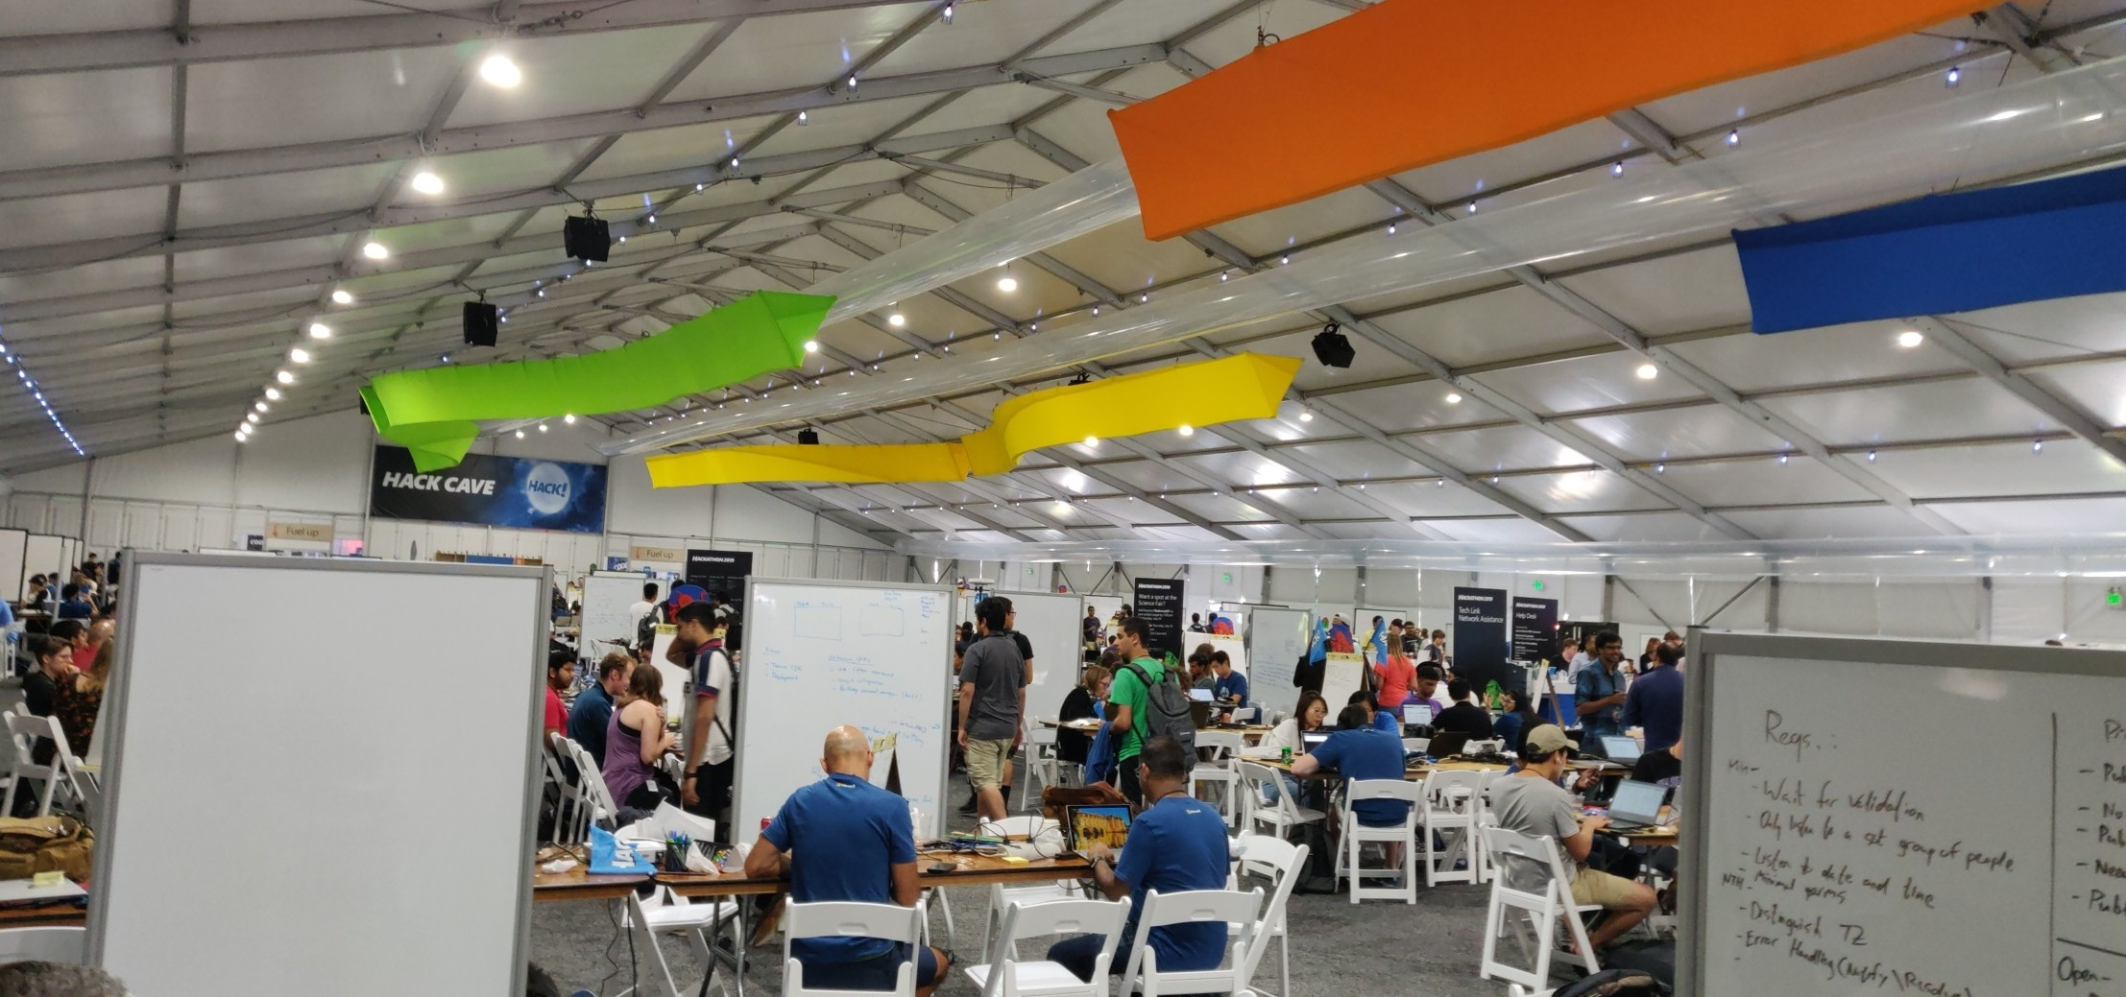


Context
Microsoft hosts an annual week-long hackathon where employees are encouraged to work on whatever interests them.
Some of these projects turn into real products, the best example of this is the Xbox Adaptive Controller:
Notes:
* largest private hackathon in the world!

Slide 4
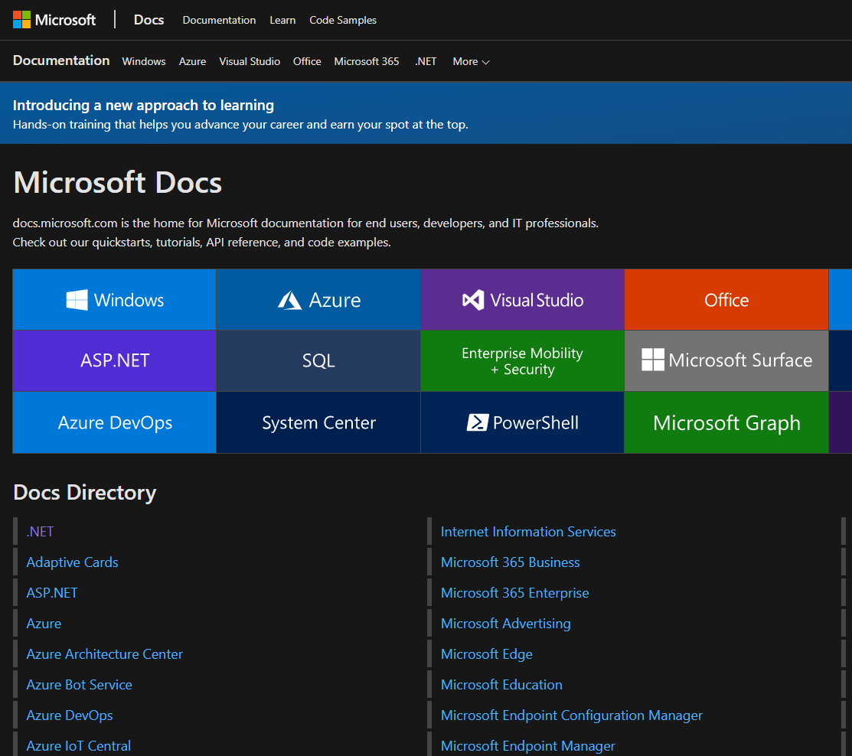
Problem Statement
I teamed up with some technical writers in the team behind docs.microsoft.com, which is the documentation site for all things Microsoft.
They use GitHub repos to maintain their documentation.
GitHub Actions wasn't out yet.
When changes are merged to master, they are automatically deployed.
There’s no way for them to “hold” content until a specific time/date.
A PR that’s hours to months old could easily be forgotten.
Nobody wants to merge a PR outside of business hours.
Notes:
Met technical writers using our internal project match-maker website. People with ideas post their ideas, people who are looking for teams can join them. Don't work with them, never met them before.

Slide 5
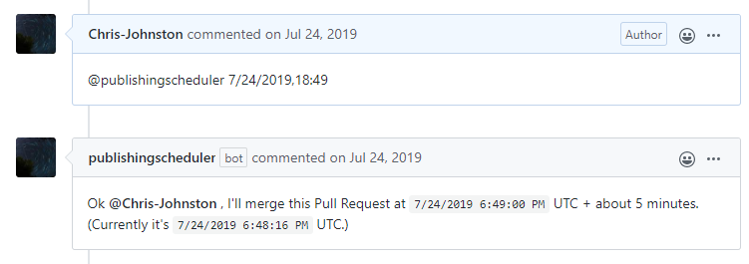
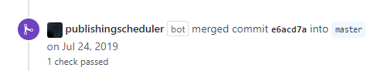
Meet Publishing Scheduler
Publishing Scheduler is a GitHub App that can merge pre-approved Pull Requests at any time.
Add it to your repo, and leave this comment in any approved Pull Request:
PR gets merged by the bot in the future!

Slide 6
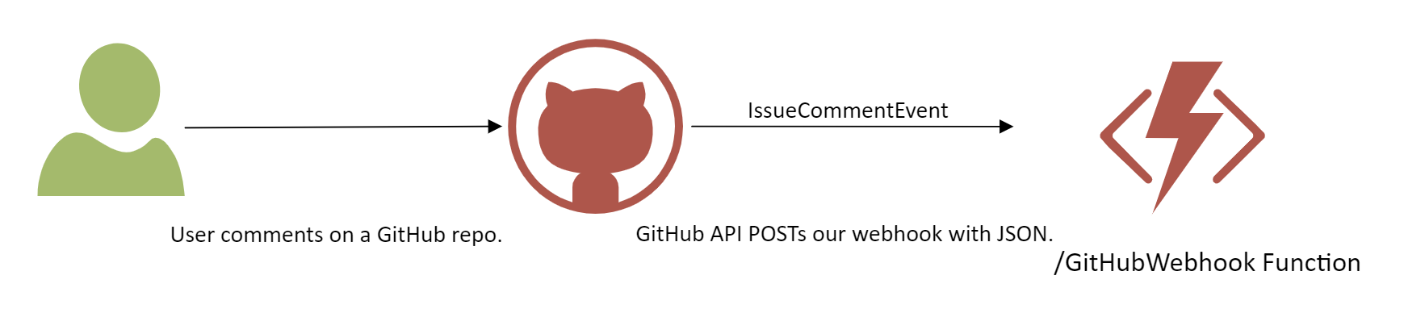
How do we build GitHub apps?
GitHub offers a REST API that allows developers to build apps with it.
When your service talks to GitHub, you send it a HTTP request.
When GitHub talks to you, it sends you a HTTP request (these are called webhooks).
An API using webhooks is effective, since GitHub can directly notify your service about events when they happen.
Pro: No polling required!
Con: Requires that you have a server that GitHub can reach.
https://developer.github.com/webhooks/
Notes:
Talk about how webhooks are great for prod applications, but add overhead to a hackathon project when you just want to move fast.

Slide 7

Choosing our tools
The GitHub API is over HTTP, so it’s language/tooling agnostic.
Here’s how my team decided on what tools to use:
Most of my team uses C#
GitHub has a pretty good library for C#/.NET: Octokit.Net
We need some web server to accept GitHub webhooks, and nothing else
We expect traffic to this server to be inconsistent and infrequent
https://github.com/octokit/octokit.net
Notes:
The user is only going to interface with this bot via GitHub, so we don't need to set up our own front-end.
We think that the traffic will be inconsistent/infrequent, given that this is a hackathon, and we only need to act whenever the user comments.

Slide 8
Choosing our tools
ASP.NET
An entire open-source framework for building web apps and services
Supports MVC pages, user authentication, etc.
Runs behind a webserver, which is always on
Comparable to Java Swing, Python Flask, etc.
Free to host on Windows or Linux, but pay for the VM that you use
Azure Functions
Azure’s event-driven serverless compute platform
Can be triggered by HTTP, storage, and more
Only runs when we need it to, 99.95% SLA
Comparable to AWS Lambda, GCP Functions
Pay for the execution you use, only runs on Azure (or debug locally)
Notes:
Given this criteria, we need to pick a web server stack that’s best for our application:
ASP.Net is more like a traditional web server that we might use for some larger web apps. (Stackoverflow uses it)
Azure Functions is a serverless approach which we could use for a microservices based architecture.
Our main requirements for this were:
GitHub has to talk to us (and only GitHub)
We only expect 1 type of input, webhooks
We expect this traffic to be inconsistent
While we could use ASP.NET for this, it’s more than we need. We went with Azure Functions (also means we save $ on compute)

Slide 9
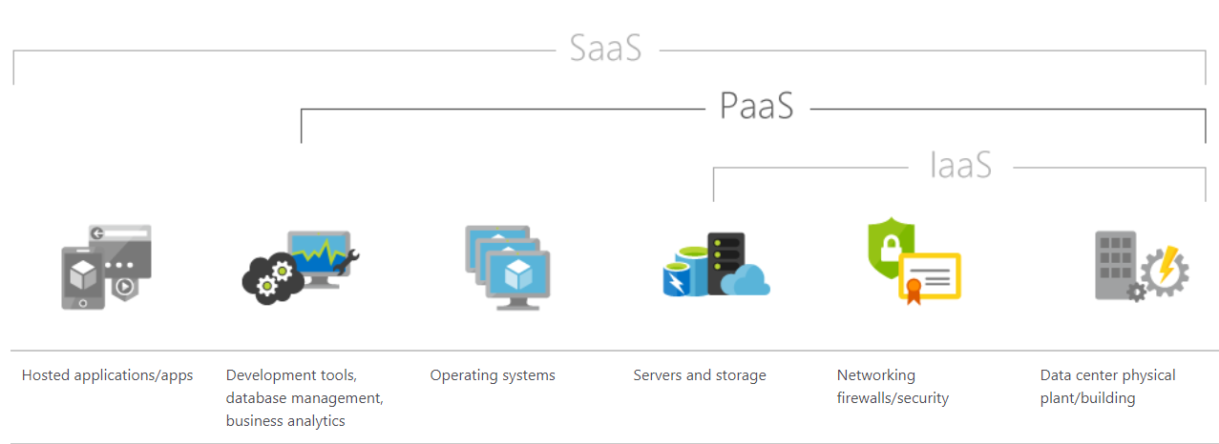
Choosing our tools
ASP.NET can run anywhere, but we’d still need to provision a dedicated virtual machine and storage to keep it running. With Azure Functions, the infrastructure is abstracted away for us. We only pay for the compute time we use.

Slide 10
CHOOSING OUR TOOLS
In the end, we chose to use Azure Functions over ASP.NET for the following reasons:
We only need an API, not an entire web app w/ a front-end
We expect infrequent use, so Functions are cheaper than a dedicated VM
HTTP and Queue storage triggers will prove to be useful for us in just a moment
I wanted to learn more about how to use Azure Functions
We really could have used either one here, with some differences.

Slide 11
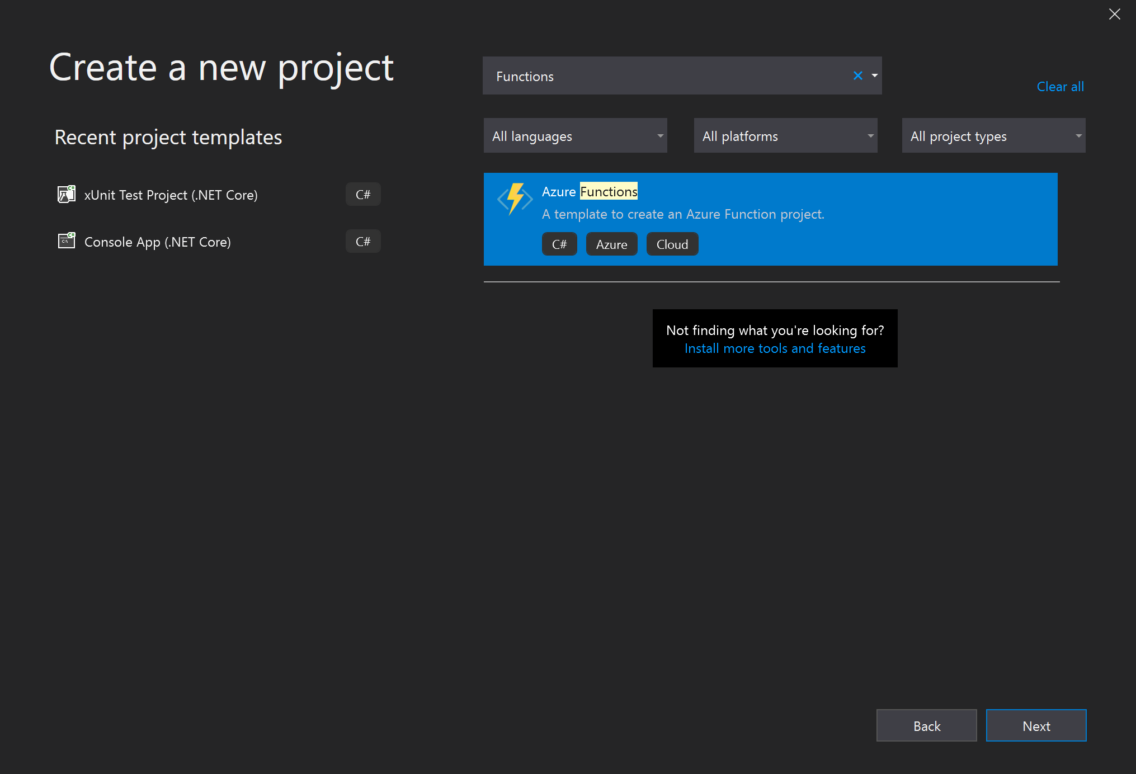
Where to start with Azure Functions?
Functions start with your code first. Visual Studio provides templates which make it easy to get started.

Slide 12
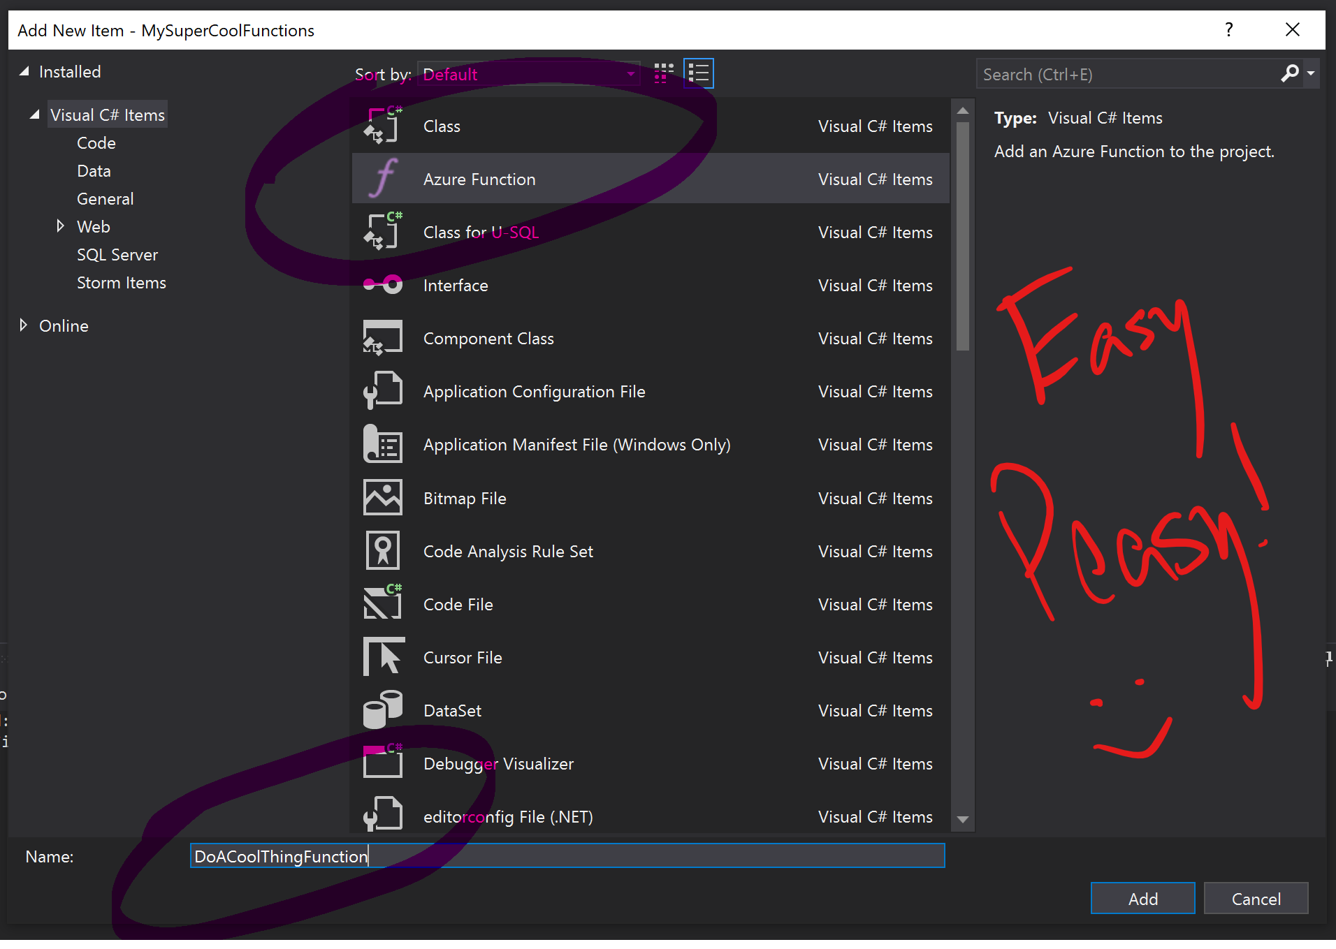
Where to start with Azure Functions?
Create a project, and add some Functions to it.

Slide 13
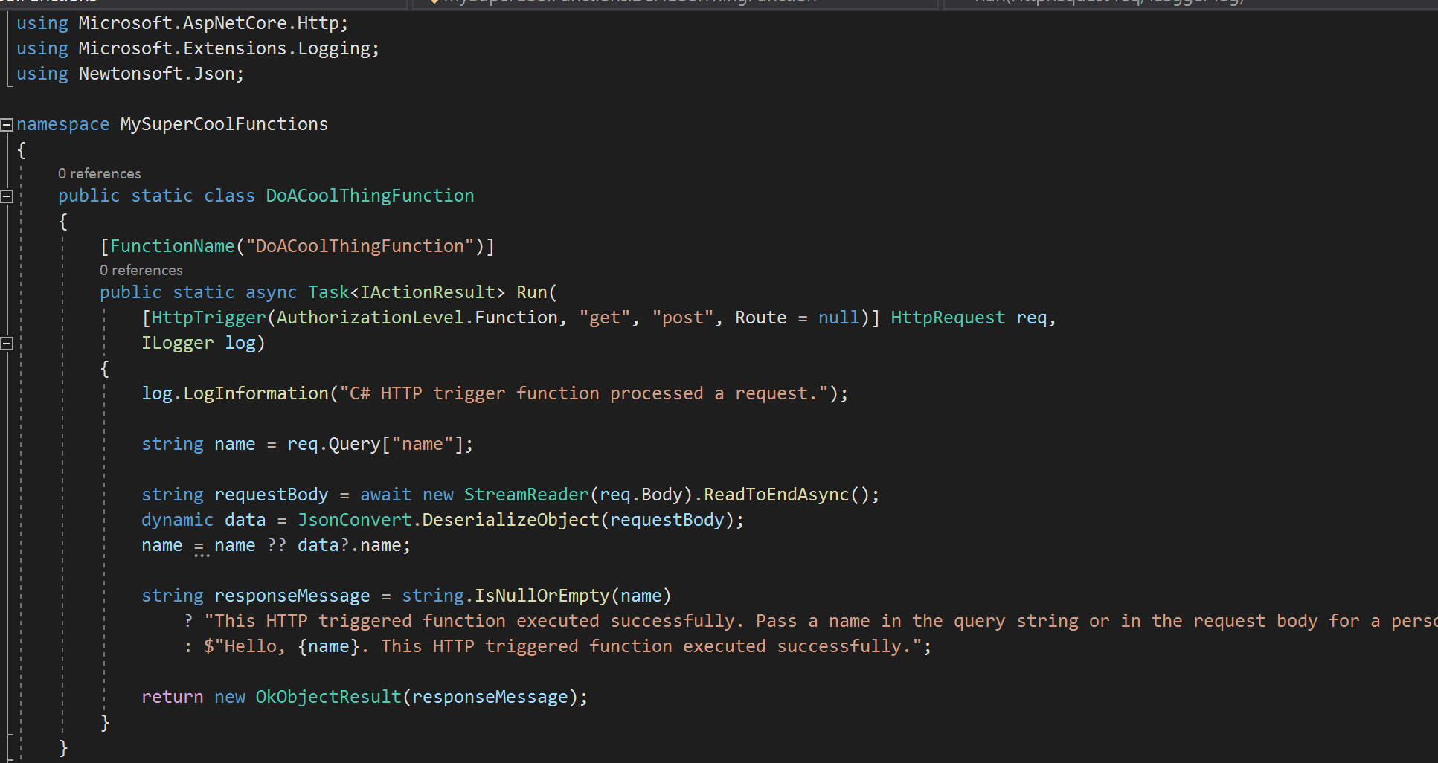
Where to start with Azure Functions?
And suddenly we have a whole bunch of code!

Slide 14
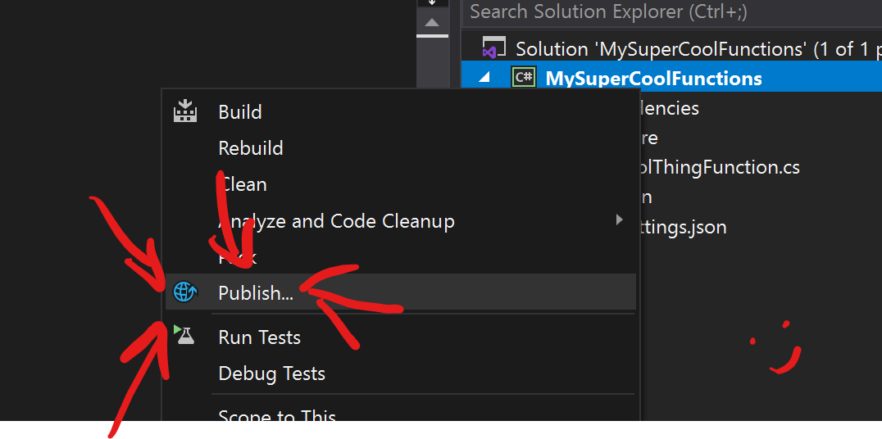
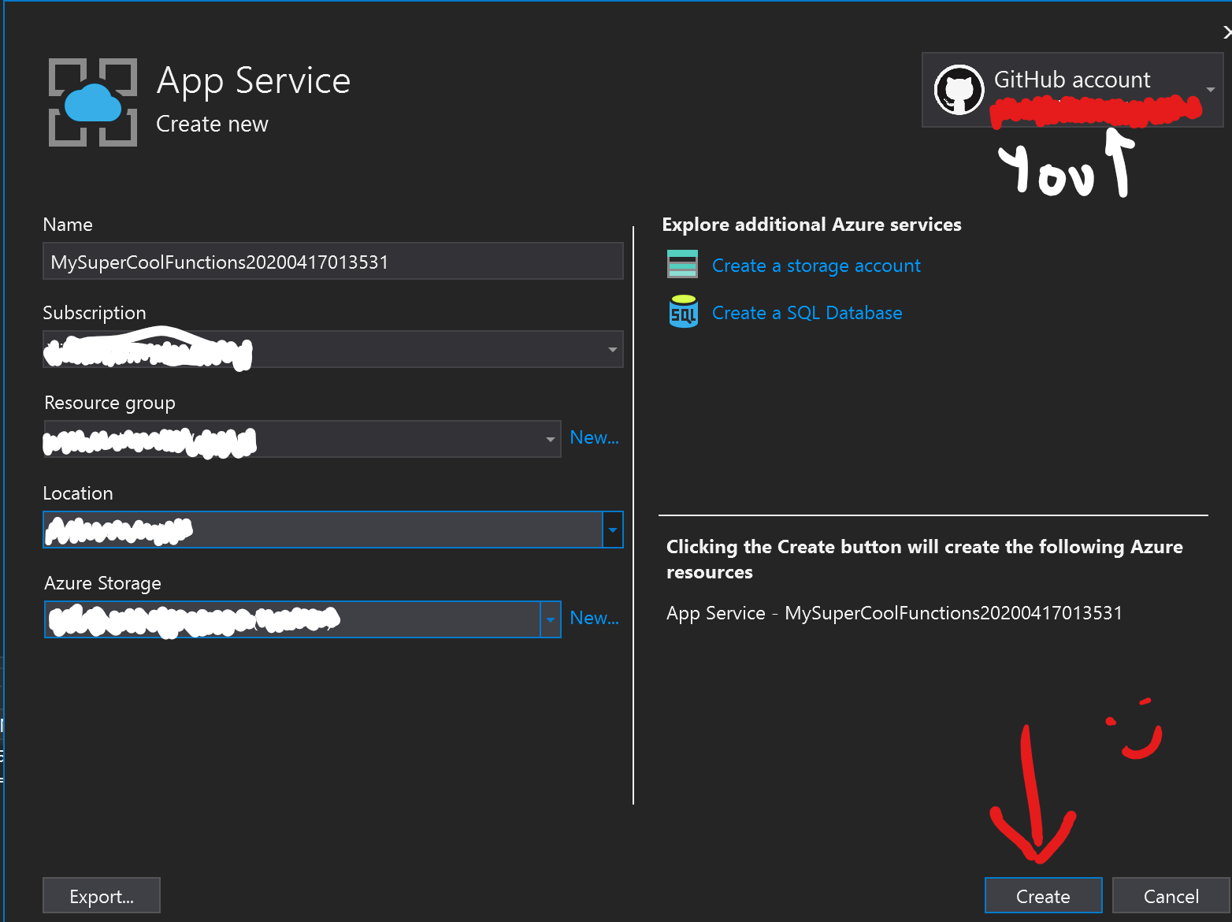
Where to start with Azure Functions?
If we want to deploy this code, we can just click "Publish". After we sign in, we can provision our resources and upload our code.

Slide 15
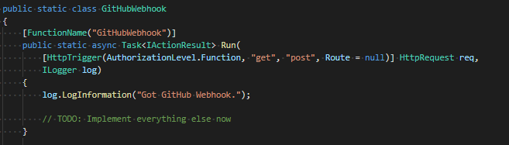
Where to start with Azure Functions?
Azure Functions uses attributes on your methods to define when and how it’s called, instead of being configured elsewhere. This snippet defines the webhook that GitHub uses to talk to us.
The attribute [FunctionName(“GitHubWebhook”)] defines this method as a new Function (named GithubWebhook).
The [HttpTrigger(…)] attribute defines that we can send GET or POST HTTP requests to this Function to trigger it.
Notes:
It may sound odd, but just start writing code! Azure Functions uses attributes to decorate functions and their parameters to figure out how to call your function. Once it’s deployed, it’s up and running.

Slide 16
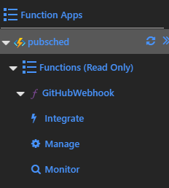
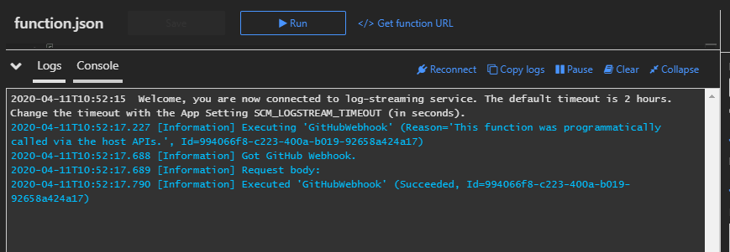
Where to start with Azure Functions?
Once it’s deployed, our Functions should show up in the list.
We can test this from within the Azure Portal itself:
Notes:
You may have to squint a bit, but we can see in our logs that the message "Got GitHub webhook" appears. (Even though we actually just triggered this from within the portal)

Slide 17
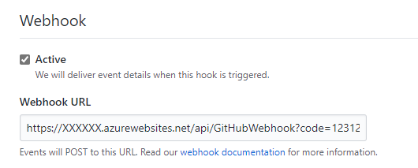
Hooking it up to GitHub
Once our function works, we can use the “Get function URL” button on this page to copy the URL we need to access this endpoint.
The URL will look something like this: https://myapp.azurewebsites.net/api/GitHubWebhook?code=123abc
This includes a private token, so that random 3rd parties that aren’t GitHub can’t call this function.
We can share this URL with GitHub to allow our services to talk to each other.
Notes:
Once we have something working, we can tell GitHub to send Webhook data to our URL.
This function is configured with a private token, just so that other third parties that aren't us or GitHub can't send us false data.

Slide 18
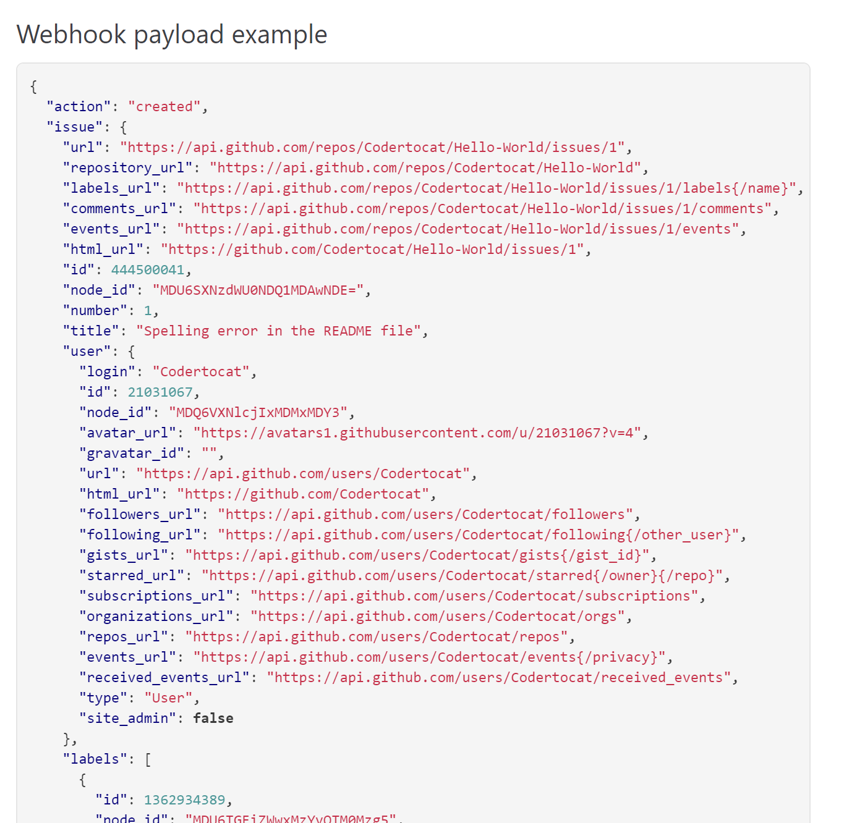
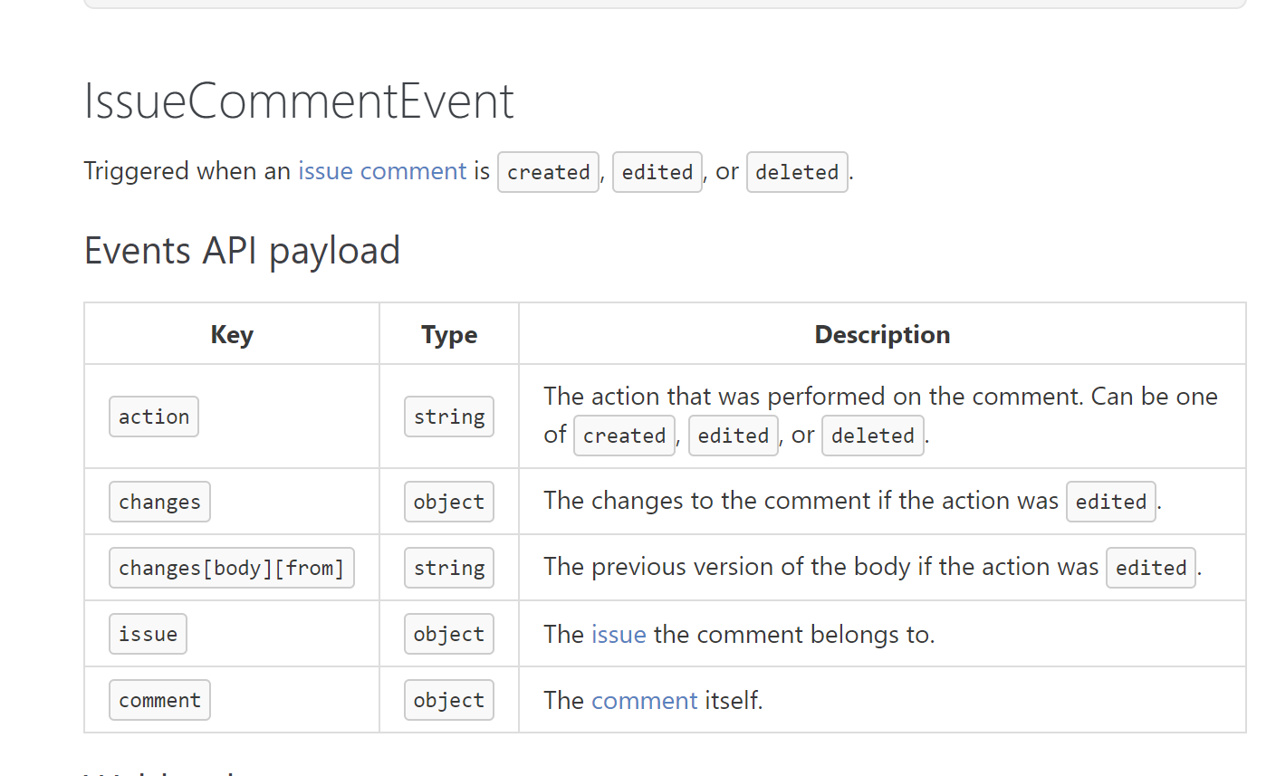
Hooking it up to GitHub
The GitHub webhook will then send POST us data for each of the events that we care about:
Notes:
Included here is an example of the IssueCommentEvent payload, which is sent when a user leaves a comment on an issue or PR

Slide 19
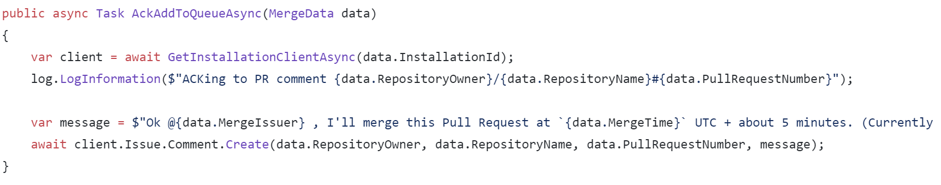
How Does our app control github?
The Octokit.Net library we use simplifies how we interact with GitHub.
We store a private token in environment variables, which we use to generate another token, which we use to authenticate to GitHub.
Once the Octokit API client has this token, we can issue requests (like creating comments, merging PRs, etc.).
Notes:
The JWT isn't used for everything, but instead specific installation tokens are used just so that if a token is leaked, all users of the github app aren't immediately affected. The JWT is set to expire in 10 minutes after it's created. Also means that apps may have different permissions depending on where they are "installed", and that apps can't do anything unless users add them to their repos.
The screenshot included is a snippet of our code, where we acknowledge the user's comment to merge the PR at a future date.
Update: removed details about JWT

Slide 20
Queues: Publish scheduler’s “Secret sauce”
Great, now our app is hooked up with GitHub and we can hack on reading the webhook payload to do something with it.
From a user’s POV, our app does the following:
We leave a comment for it to go merge the current PR in some time in the future (can be months).
The app acknowledges this comment.
The app waits for the amount of time requested.
The app merges the current PR.
How do we delay for months in a way that is effective, while still being accurate within a few minutes?

Slide 21
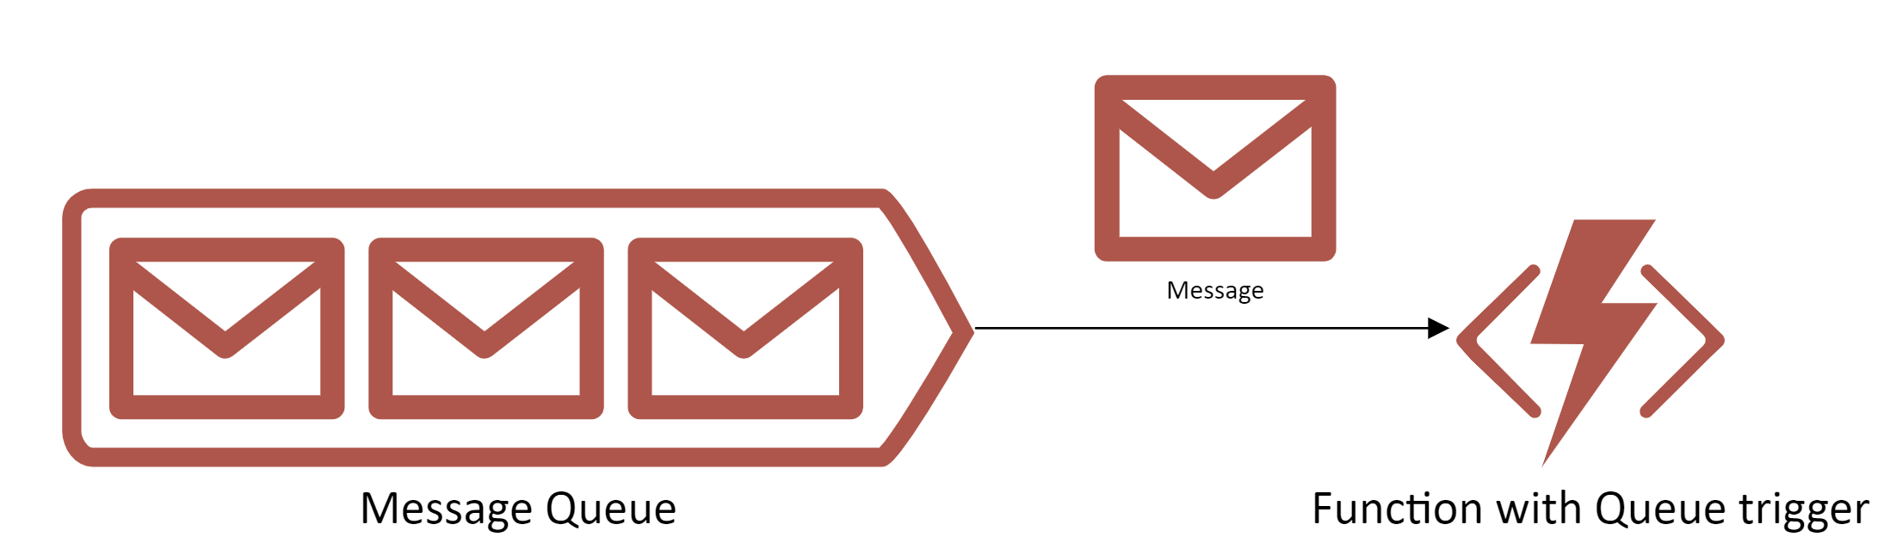
Azure Queue Storage
Azure Queue Storage is a message queue system that works great with Functions. It's just a queue, First In First Out.
When items are added to Queues, they can trigger Functions which consume the message provided.

Slide 22
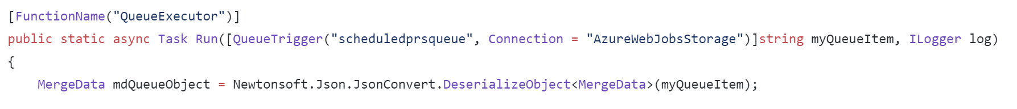
Azure Queue Storage
Azure Queue Storage is a message queue system that works great with Functions. It's just a queue, First In First Out.
When items are added to Queues, they can trigger Functions which consume the message provided.
In this example, this "QueueExecutor" function listens to the "scheduledprsqueue" for messages, and converts them from JSON.
Notes:
This sort of architecture is great at enabling a microservices approach for a system, since you can chain queues and functions together. Azure Functions are super scalable, since they aren't tied to specific VMs, which also makes it great for a distributed project where you can benefit from multiple workers.

Slide 23
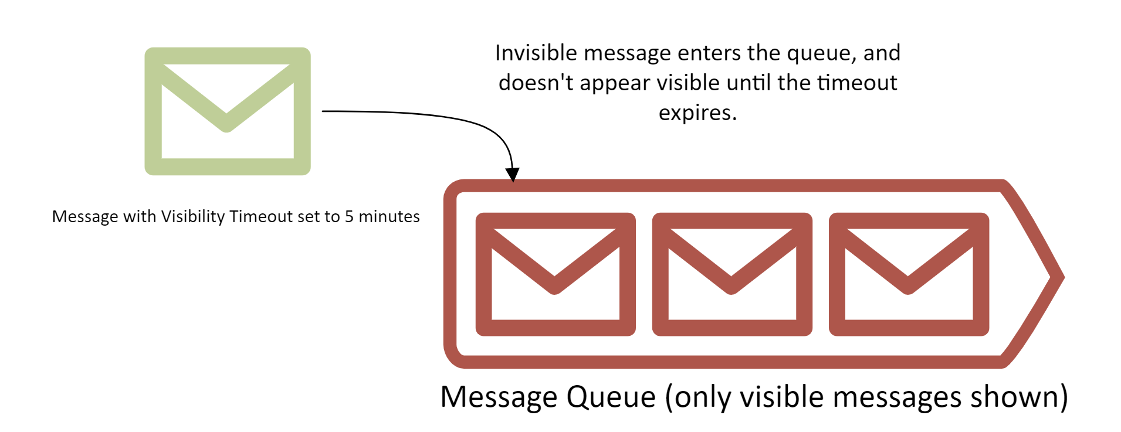
Queues: Publish scheduler’s “Secret sauce”
When inserting messages into the queue, we can specify a "visibility timeout". Messages with a visibility timeout will not appear in the queue until this timeout expires, which can be up to a week.
Notes:
Visibility timeout is how we get this all to work.
It has a number of uses, the most practical one being exponential backoff. If an item in a queue is failing, you want to delay longer and longer before trying it again.
Scrapped text
Azure Queues lets us specify some options when inserting new messages into the queue. The “Visibility Timeout” option is how we made this work.
Suppose one of your jobs failed, and an item in the Queue backlog had to be retried. If it’s against some external service (maybe some API is throwing HTTP 5xx errors), you may not want to instantly retry, which could happen if the queue only contains that failed job.
The visibility timeout option lets us insert items into a queue, but they cannot be seen (or dequeued) until the specified timespan has passed, which is up to 7 days.
In our hypothetical example, we can exponentially back off retries for jobs that fail, so that we don’t spam an API that’s already down.

Slide 24
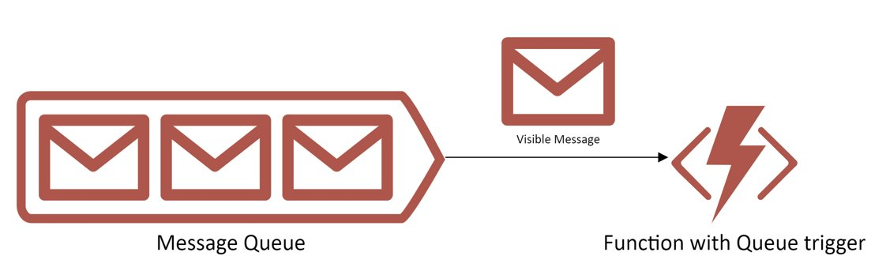
Queues: Publish scheduler’s “Secret sauce”
Once a message becomes visible, it can be picked up by a Function. This way, we can delay processing this message for up to a week at a time, without any compute from us.
But how do we wait for longer? We can re-add to the queue!
Notes:
Note: we didn't get this working for the actual app lol
In our app, the timestamp that the user specifies is included in the message payload.
If the timestamp is < 7 days from the server time, set the visibility timeout to this timespan.
Else, set visibility timeout to 7 days.
Then, when our function gets this message next, check if the current time is after the requested timestamp.
If it is, then process the message. If it isn’t, re-add the message to the queue using the criteria from before.

Slide 25
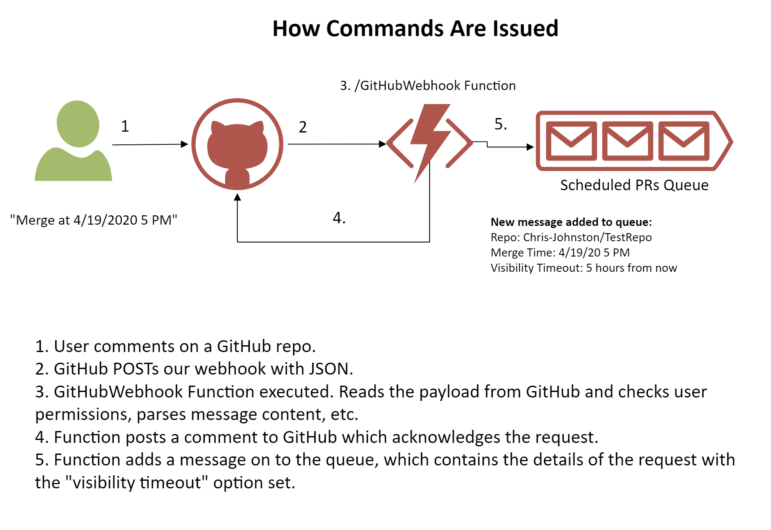
Putting it all together

Slide 26
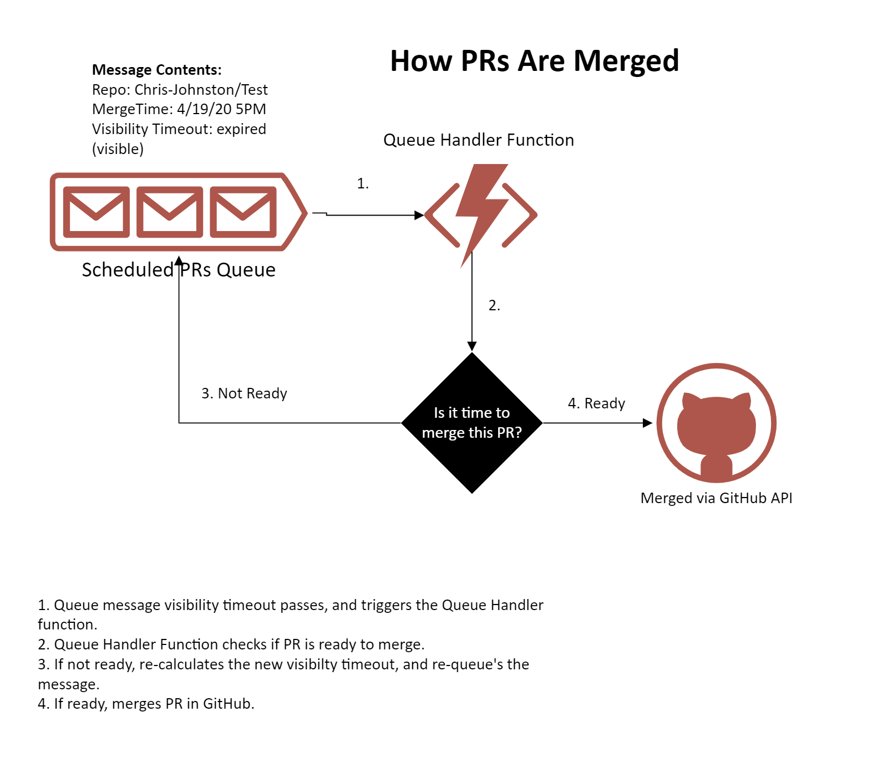
Putting it all together

Slide 27
Acknowledgements
This project was built by:
Chris Johnston: https://github.com/Chris-Johnston
Dani Halfin: https://github.com/DaniHalfin
KC Cross: https://github.com/KCCross
Resources:
GitHub API: https://developer.github.com/v3/
Azure Functions Docs: https://docs.microsoft.com/en-us/azure/azure-functions/
Azure Queues Docs: https://docs.microsoft.com/en-us/azure/storage/queues/storage-queues-introduction

Slide 28
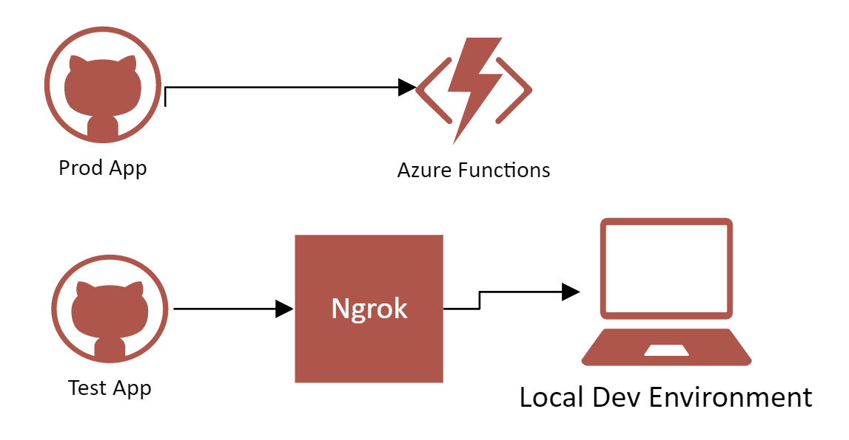
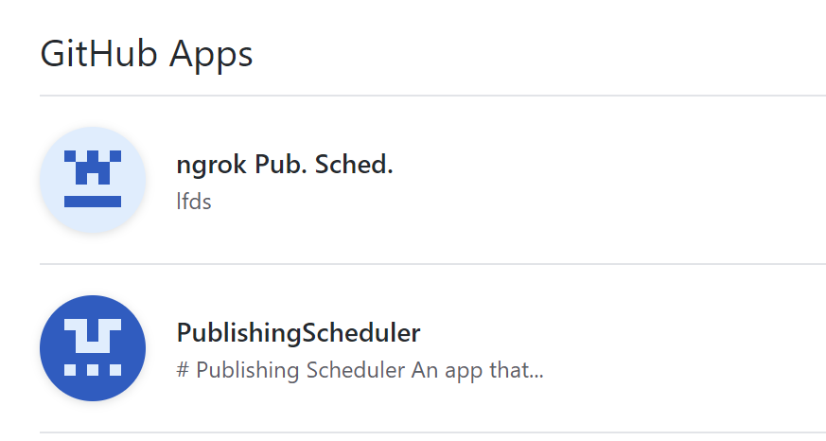
Extra TidBit: nGROK
Ngrok (https://ngrok.com/) is a fantastic tool for hackathons. It can expose your server running on localhost to a public endpoint which can be reached by other computers, phones, and even services like GitHub!
Here's how we used it with Publish Scheduler:
"Prod" webhook goes to Azure Functions
"Test" webhook goes to Ngrok, which goes to our dev machine for debugging locally

